Slide 1

Image recognition using python
Done by:
GUIDE:

Slide 2
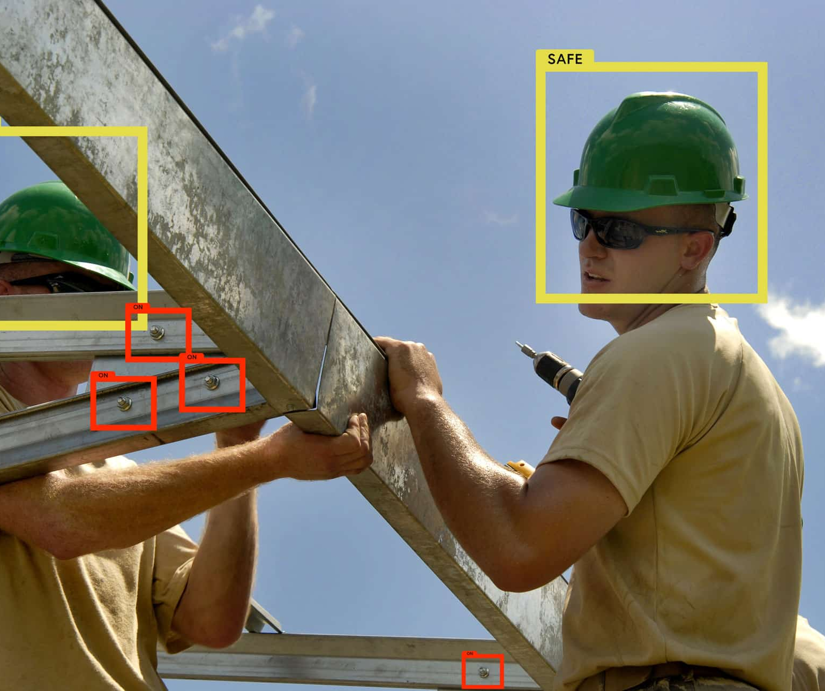
introduction
Image recognition, in the context of machine vision, is the ability of software to identify objects, places, people, writing and actions in images. Computers can use machine vision technologies in combination with a camera and artificial intelligence software to achieve image recognition.
Image recognition is used to perform a large number of machine-based visual tasks, such as labeling the content of images with meta-tags, performing image content search and guiding autonomous robots, self-driving cars and accident avoidance systems.

Slide 3
Abstract
While human and animal brains recognize objects with ease, computers have difficulty with the task. Software for image recognition requires deep learning. Performance is best on convolutional neural net processor as the specific task otherwise requires massive amounts of power for its compute-intensive nature.
Image recognition algorithm can function by use of comparative 3D Models, appearances from different angles using edge detection or by components.
Image recognition algorithms are often trained on millions of pre-labeled pictures with guided computer learning.

Slide 4

Methodology
Include text explaining the actions, or background, leading up to the historical event.
Image Recognition Methodology
Get Original Image
Get Crop Image
Match the cropped and original image
Detected objects

Slide 5

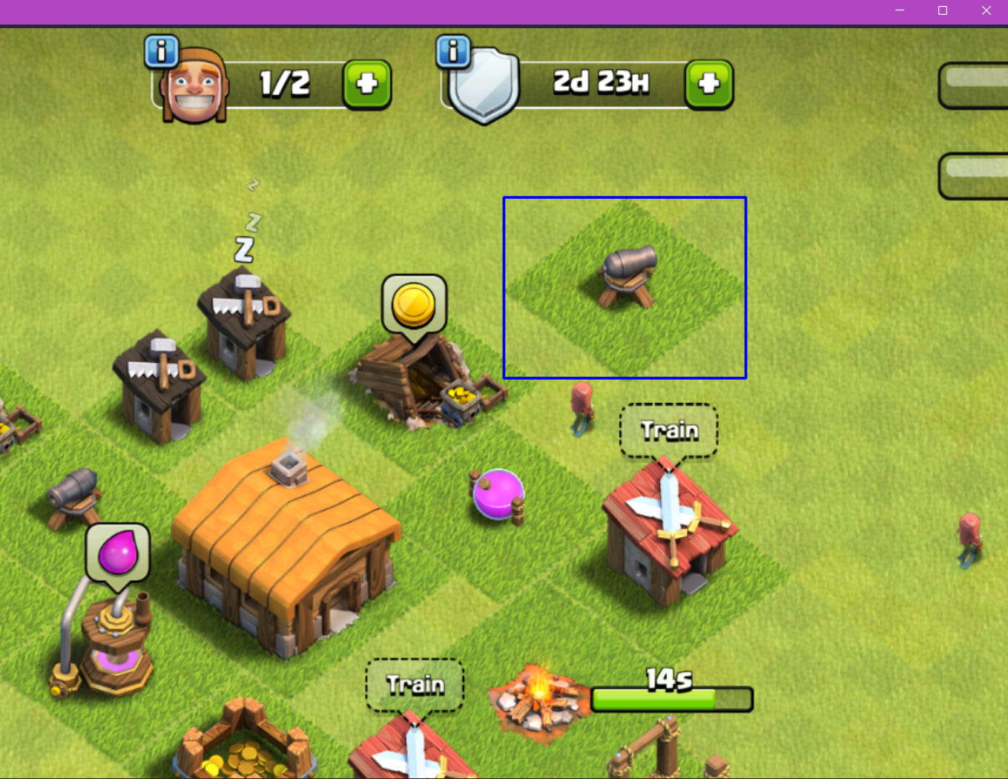
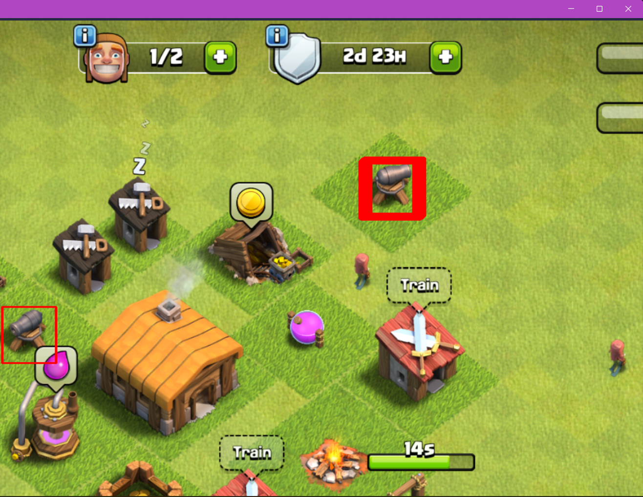
Single vs multiple object detection
Screenshot of Single Object Detection
Screenshot of Multiple Object Detection

Slide 6

Existing & Proposed Problem
Existing Problem:
Disadvantages of Existing System
This was the main disadvantage of the existing system as it is not supported for all kinds of mobiles so later on, we developed a new version.
Becoming too dependent on technology. By uploading personal photos to the Google Assistant app, it could violate, ones privacy.
Proposed Problem:
We implemented the project in the python package of numpy and OpenCV, we detect the object in the single and multiple object detection, we should overcome the disadvantage of Google Lens, to detect the single and multiple object detection using python numpy and OpenCv

Slide 7
Advantages and disadvantages
Advantages:
remove noises.
Correct image density and contrast.
Helps to easily store and retrieve in computers.
Image can be made available in any desired formats like black and white, negative image
Disadvantages:
1) initial cost is high depending upon the system used.
2) once the system is damaged the image will be lost.

Slide 8
applications
Improving Augmented Reality Gaming and Applications.
Assisting in the Educational System.
Optimizing Medical Imagery.
Boosting Driverless Car Technology.
Predicting Consumerism Behavior.
Giving Machines a Vision.
Iris Recognition Improvement.

Slide 9
conclusion
We implemented the project only object only in the static image that ca only recognize, we can’t implement with the live images that is GIF imaged, We should implemented only for theft identification in the CCTV System and IOT for Agriculture to find the defective crops in cultivation, We will soon create and update my project to the global standard and dynamic images and that is benefit for all domains.

Slide 10
THANKING YOU!

